Slide 1
FreeBSD Contribution (10%) (Final Project) TA: Jia-Wei Fang and Kuan-Yu Lee

Slide 2
Points Distribution
(2%) Attend the talk given by FreeBSD engineer Mr. Hsu
(8%) Bug report
(0%) Find a bug in a FreeBSD function
(2%) Write a formal bug report on FreeBSD Forum / mailing lists
or create a git diff patch for a bug with a trivial fix
3. (1%) Report the bug on the FreeBSD Bugzilla and get a bug ID
(1%) Get positive feedback from the FreeBSD community on Bugzilla or mailing lists
Hence, 1 bug = 4 pts → 2 bugs = 8 pts!!!
In addition, up to 20 bonus pts can be earned by going beyond 2 bug reports!
Choose one to do

Slide 3
1. Where to find bugs
Go to freebsd-src Github:
https://github.com/freebsd/freebsd-src/tree/main
Contribution types (in this class):
Bugs you encounter when you are using ➔ FreeBSD Forum / Mailing list
Find typos on the manual pages
Add examples for the FreeBSD function
Next Step
Git diff patch
(只有一個小錯字的話git pull request就好)
Notes:
fork
Create a feature branch (建立一個branch改在裡面比較好)
Pull request

Slide 4
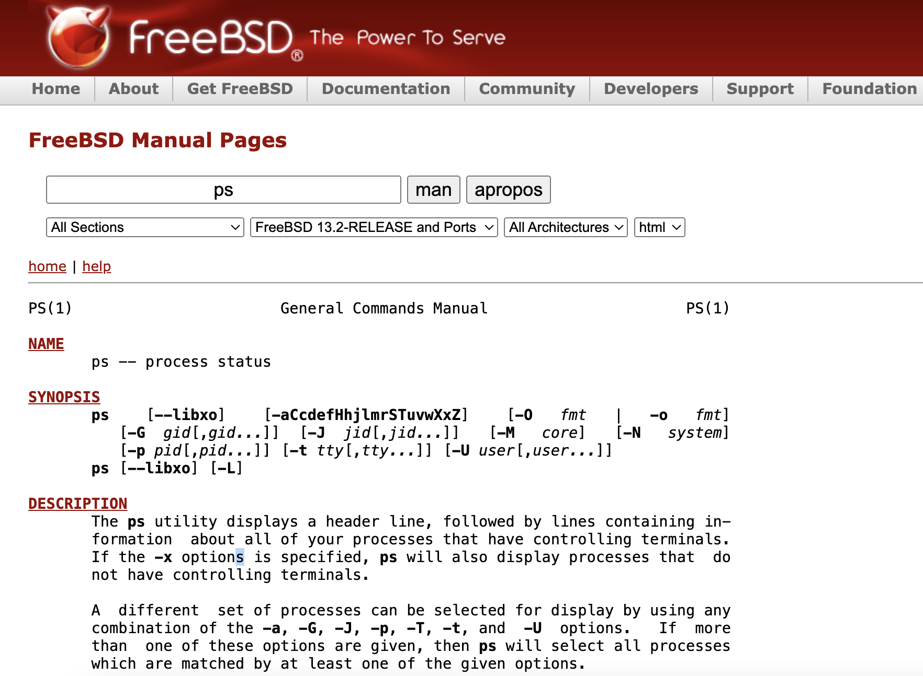
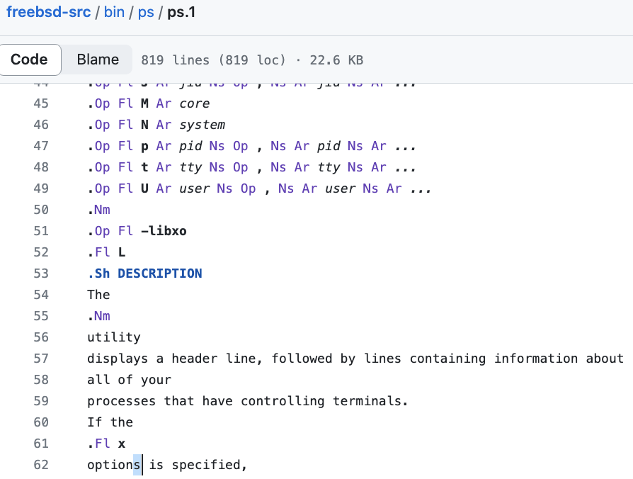
Example
(We may provide some references of how to create a git diff patch in the following weeks…)

Slide 5
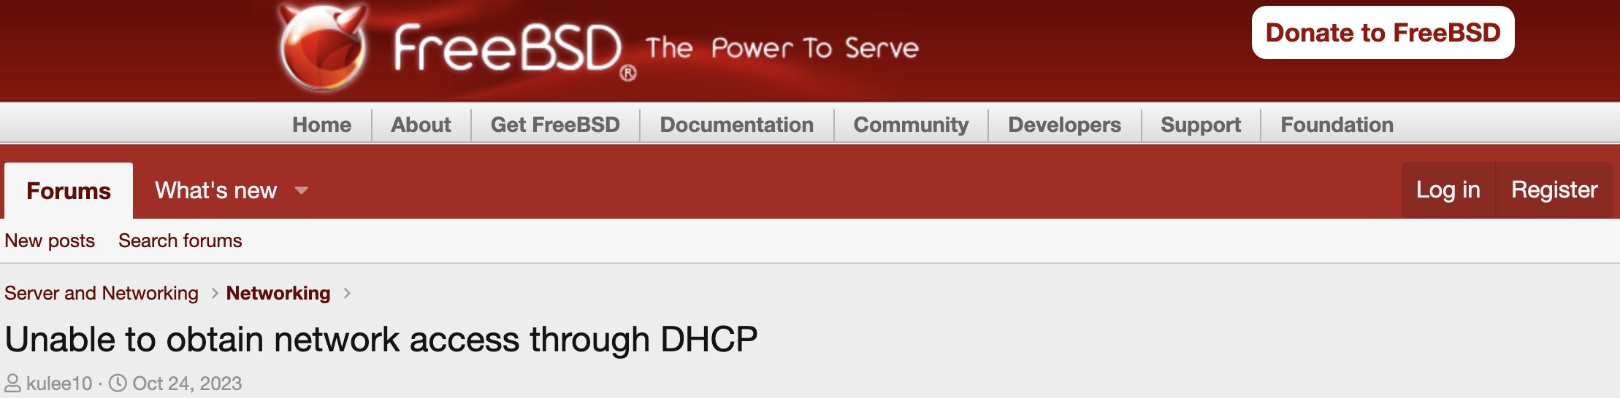

2. Post the bug on the FreeBSD Forum
Go to FreeBSD Forum and choose the most relevant field
Ex: We can not access the network through DHCP, so we post the bug report on Server and Networking > Networking
Choose a suitable title
Notes:
標題改更明顯

Slide 6
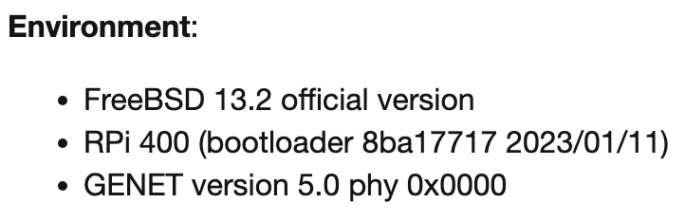
Bug Report: Environment
Clearly describe the usage environment

Slide 7
Bug Report: Description
Clearly describe your bug
Content should be concise and clear, avoiding verbose descriptions without focus

Slide 8
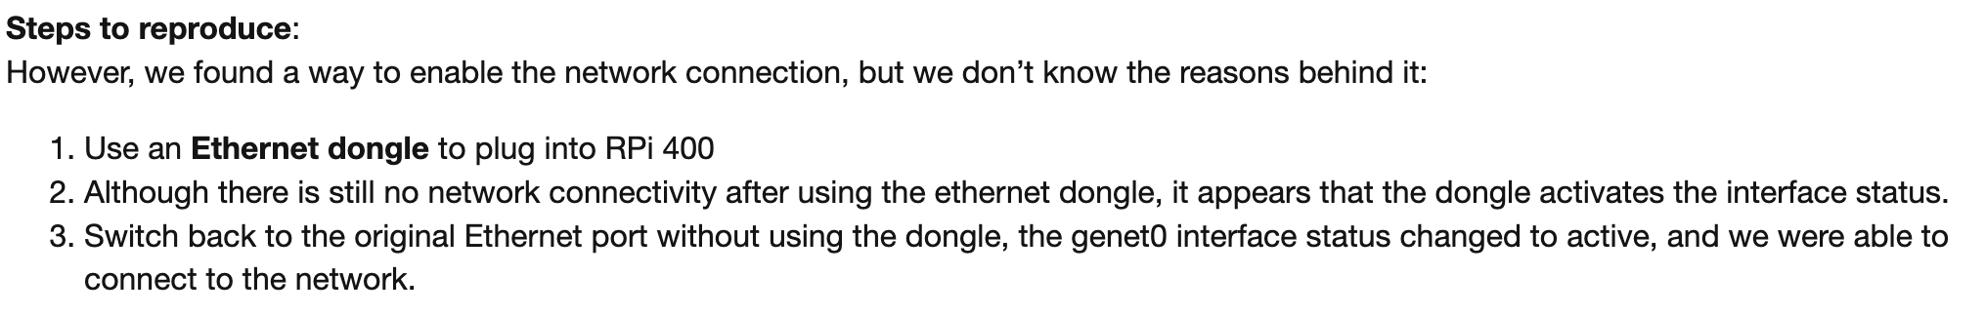
Bug Report: Steps to Reproduce
Use bulleted list or numbered list
Again, content should be concise and clear

Slide 9
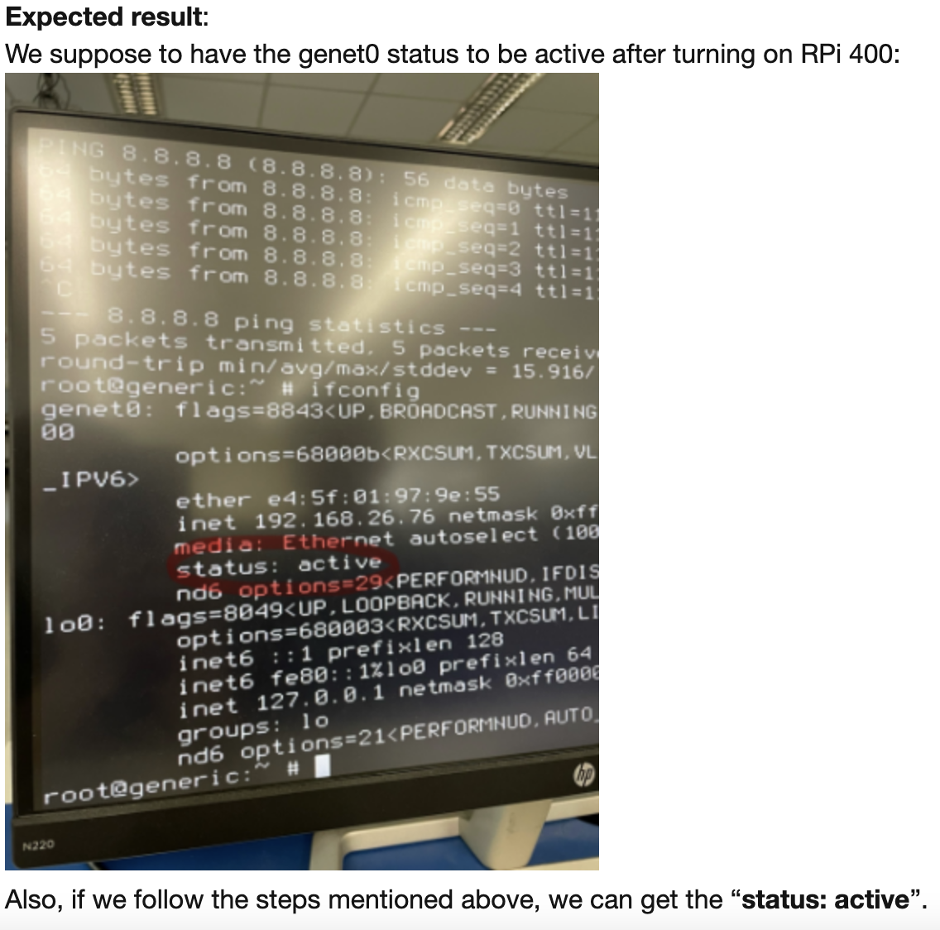
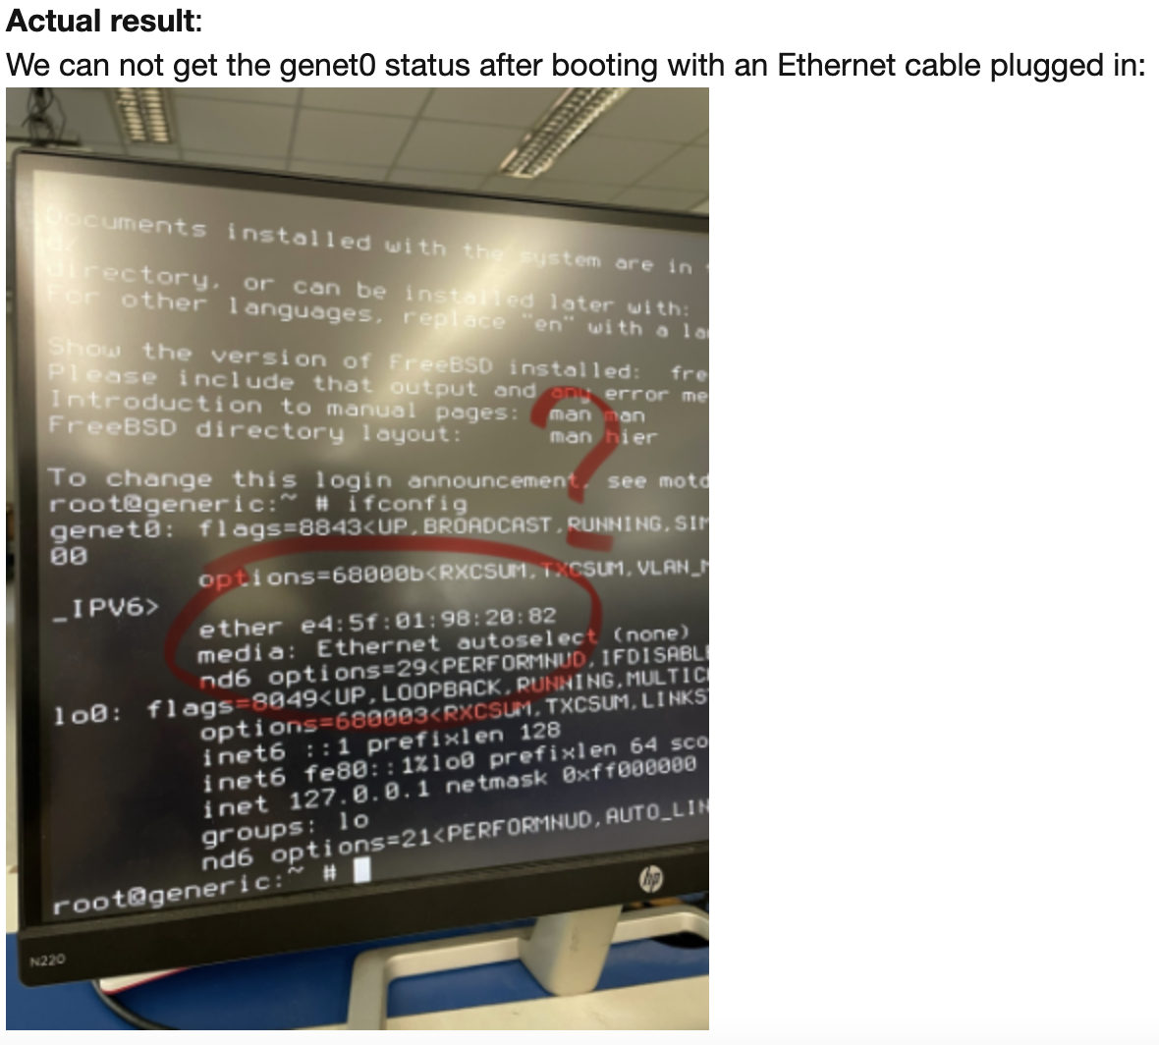
Bug Report: Expected / Actual Results
Show the expected and actual results
Always capture ASCII for illustrations rather than images (so what we show below is a no-no), because ASCII content saves electricity (hence, saves polar bears) and is searchable!.
Notes:
用文字表達圖片

Slide 10
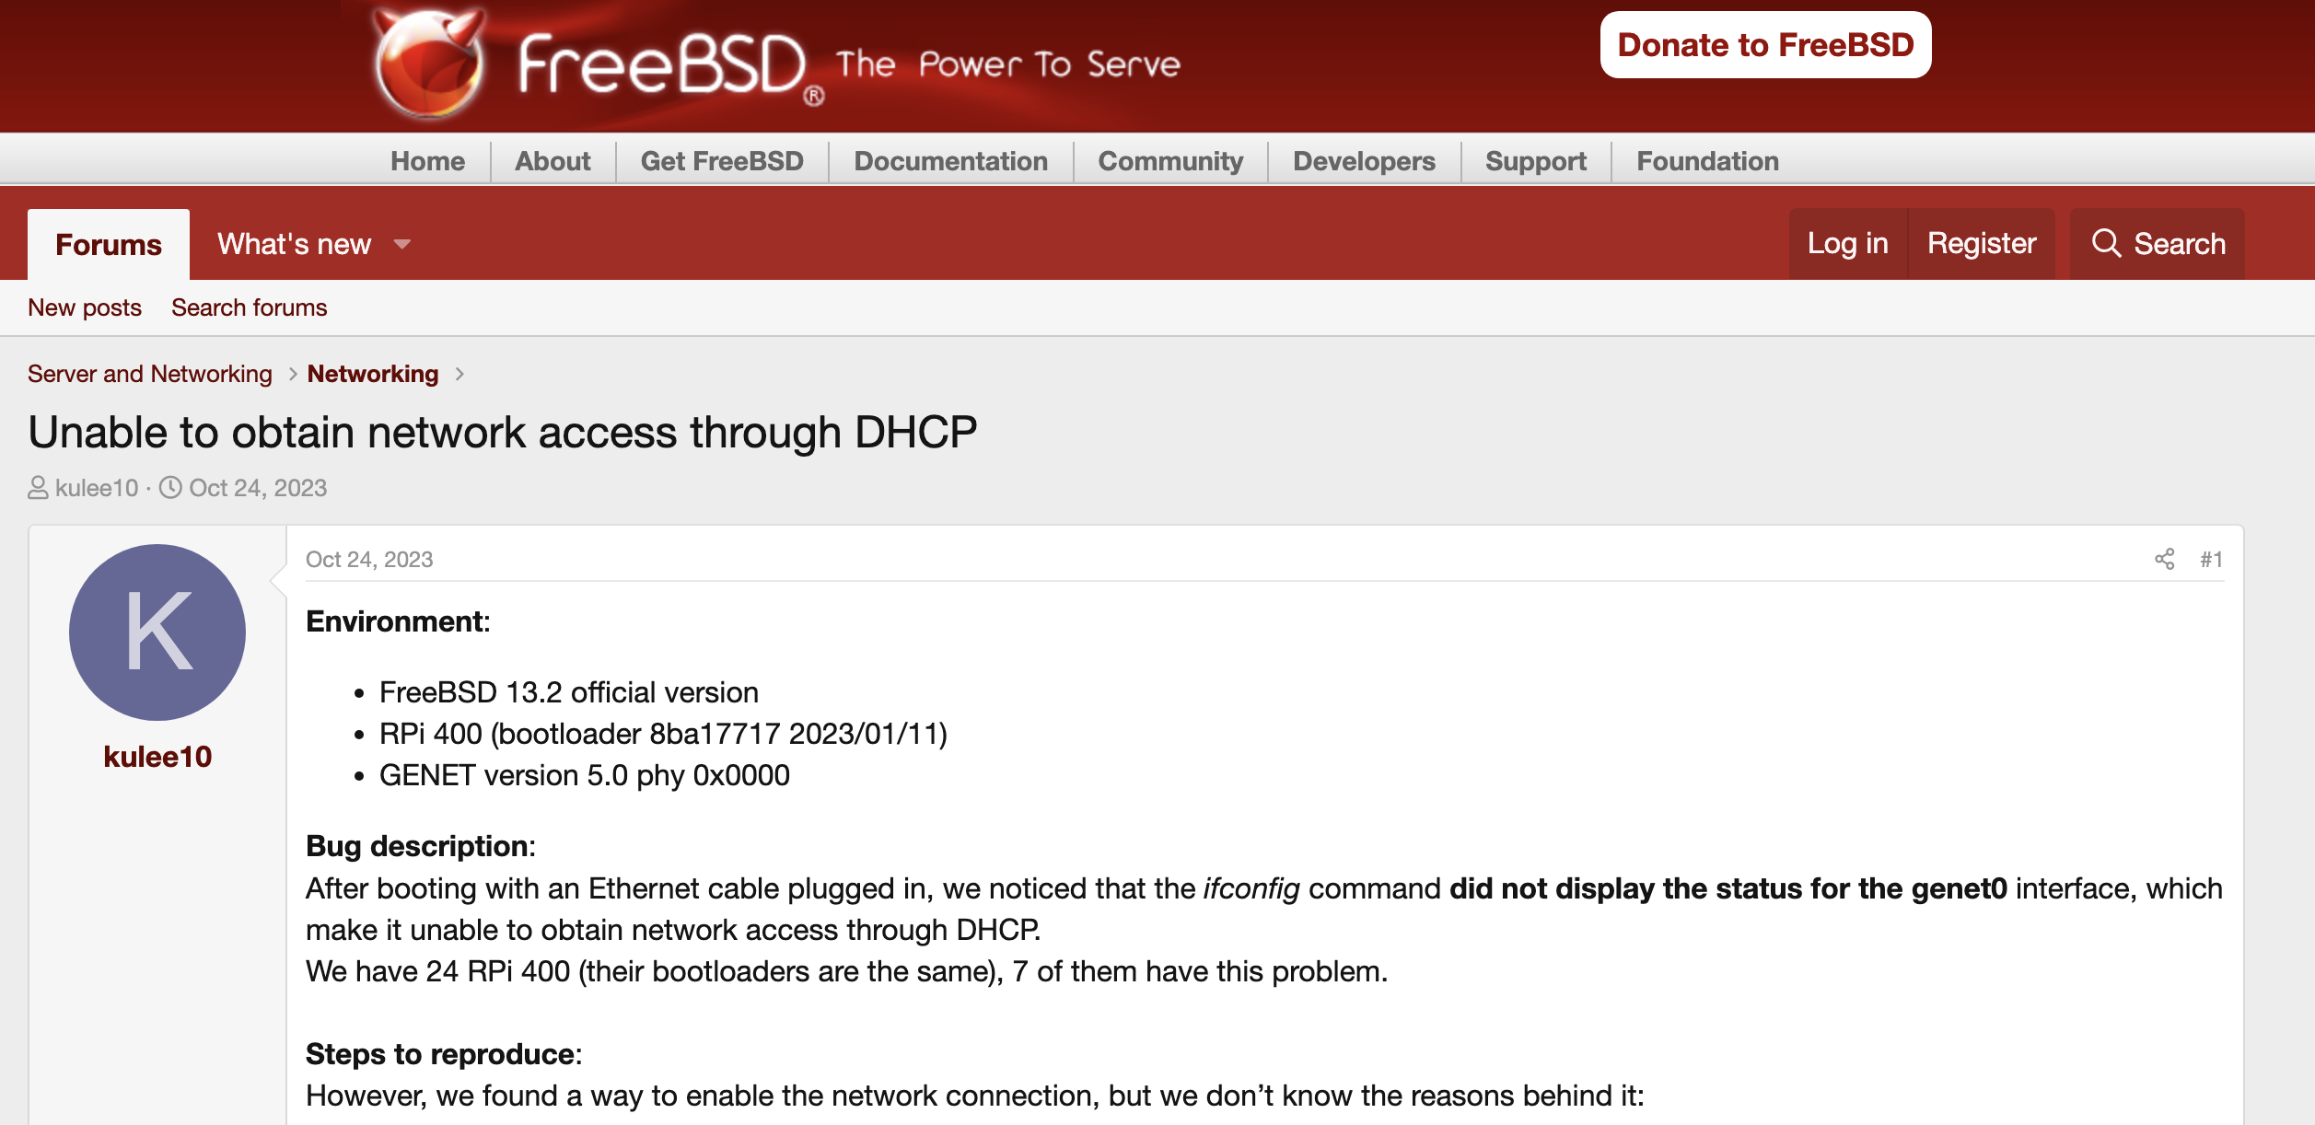
Example
https://reurl.cc/WvWyl5

Slide 11
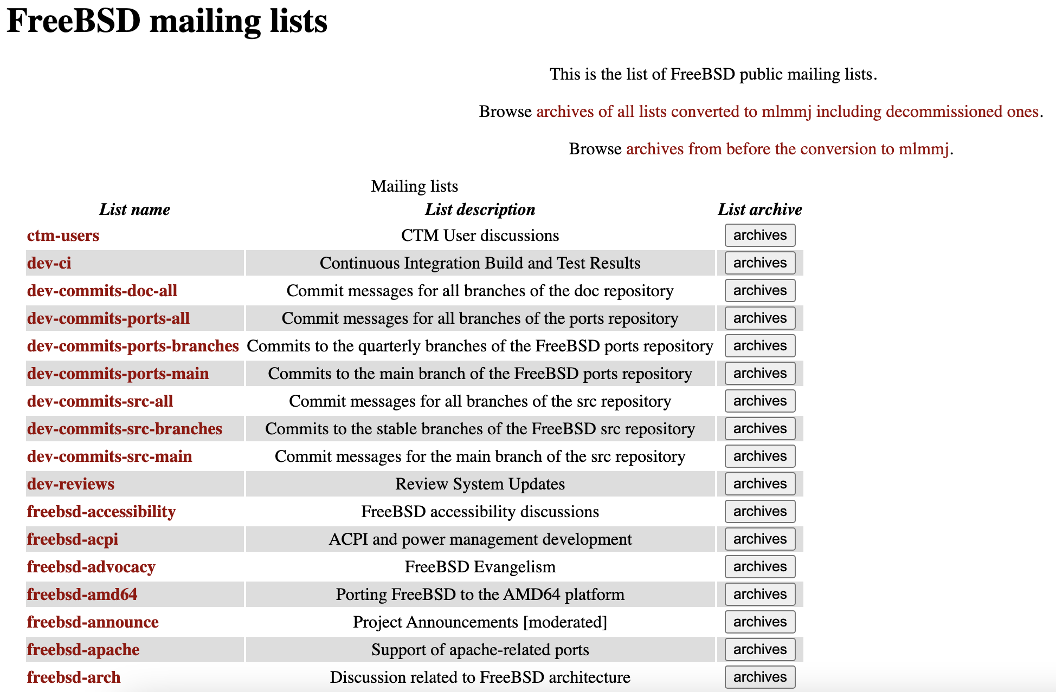
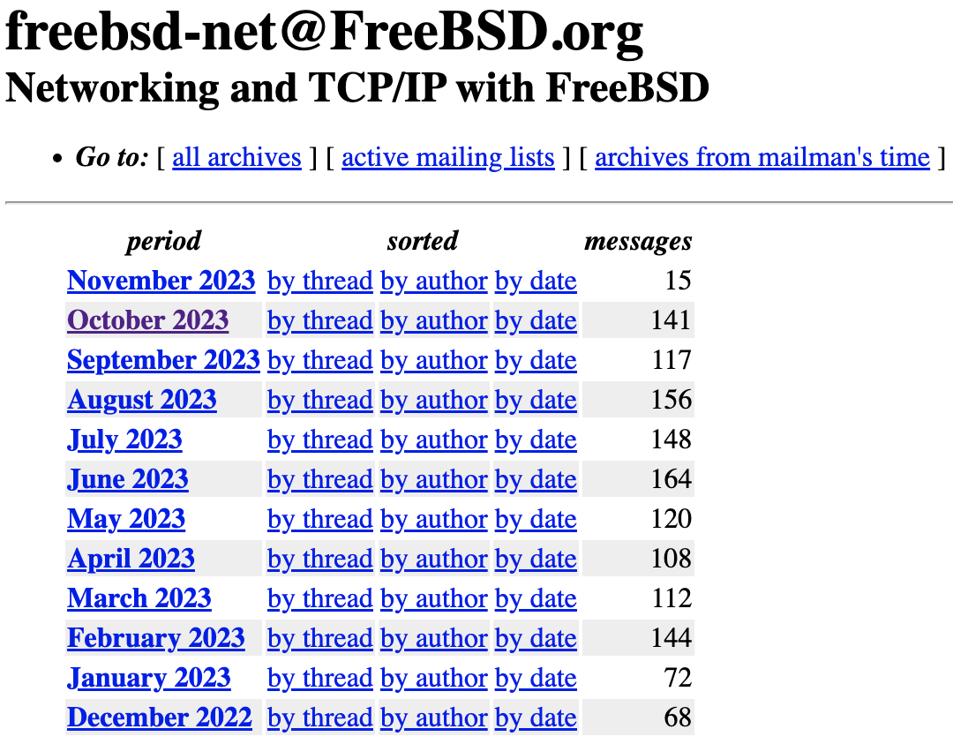
2. Send the bug report to the relevant mailing list
FreeBSD mailing lists: https://lists.freebsd.org/
Find a suitable email list
Subscribe to it, so that you can send emails to that mailing list
Send your bug report to this email!!
Choose the most relevant one
➔
➔ Your bug report will be sent to all subscribers that are interested in the bugs under this topic

Slide 12
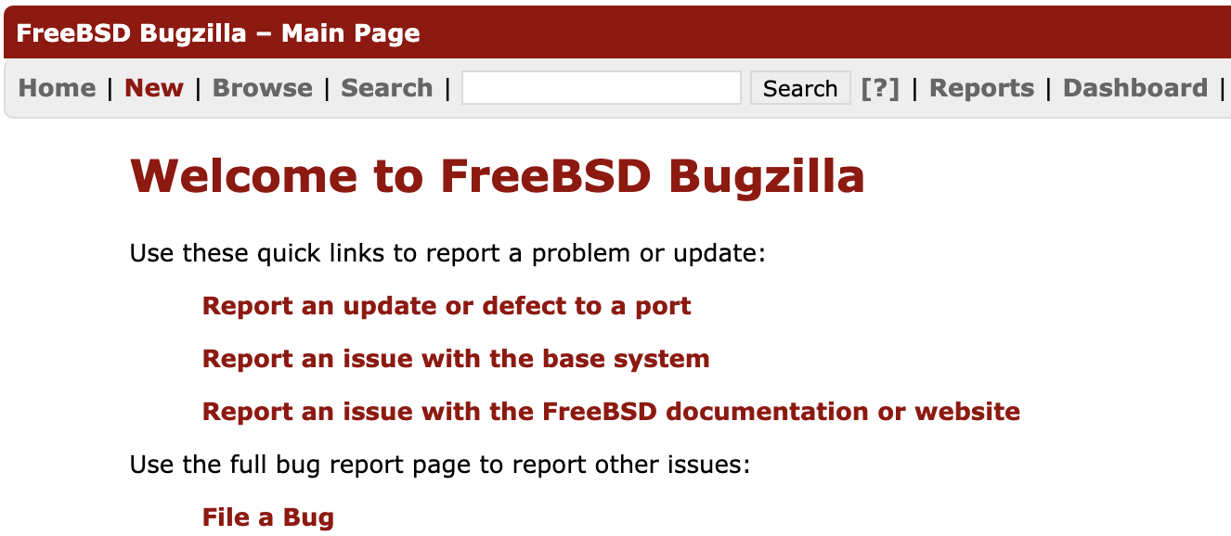
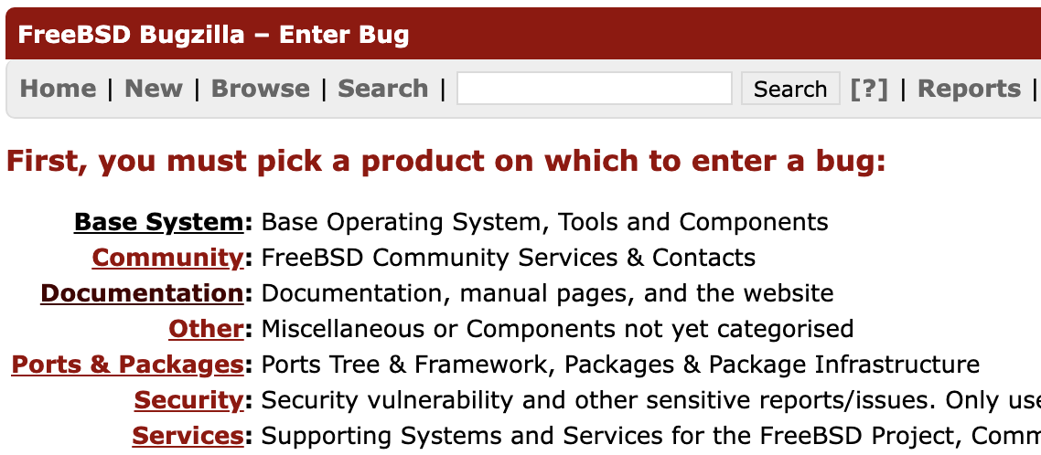
3. Report the bug on FreeBSD Bugzilla
FreeBSD Bugzilla: https://bugs.freebsd.org/bugzilla/
1. Create an account (Please use official NTHU email account with your passport name to be professional)
2.
3.
Choose the most relevant one

Slide 13
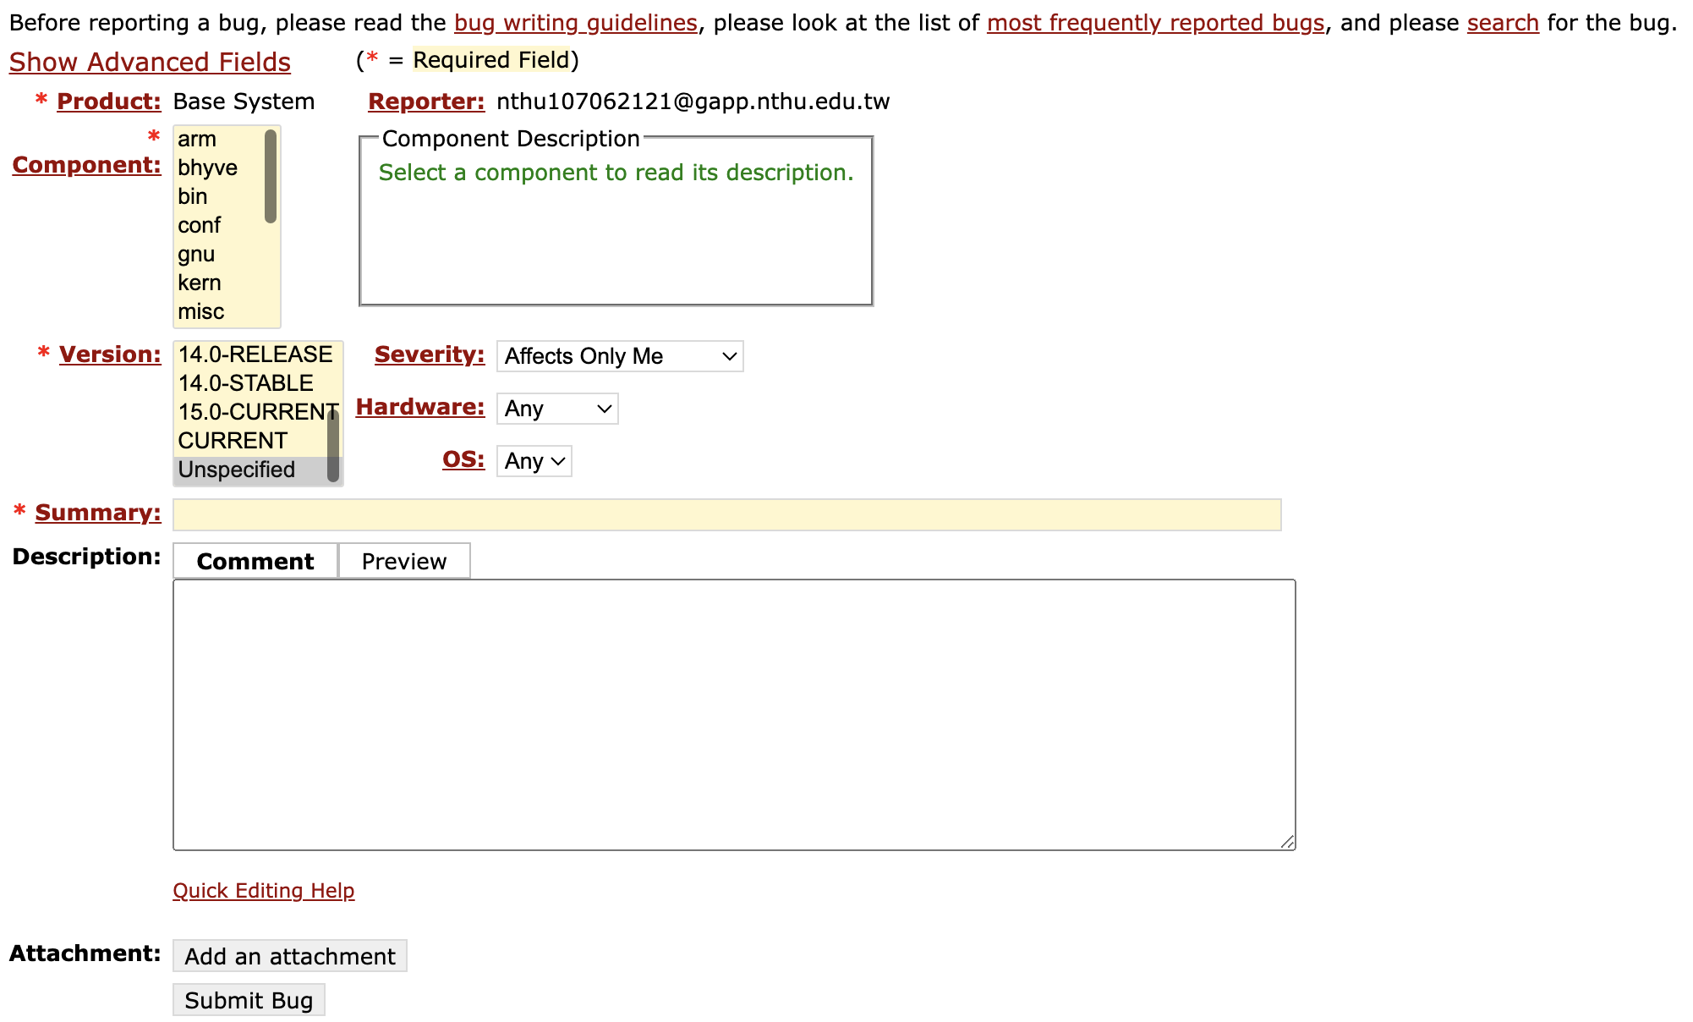

3. Report the bug on FreeBSD Bugzilla
4. Summarize your bug report along with the feedback from the forum or email (if you get any)
5. Post the description/summary on the FreeBSD Bugzilla and get the bug ID (and pts)
Fill in all the information
Again!! Content should be concise and clear!!!
Attach git patch

Slide 14
Notes
Please read the following documents:
Writing FreeBSD Problem Reports
How to Submit a Bug Report
If you are not sure whether your bug report is complete and good, you can post it on the eeclass forum, we will forward it to Mr. Hsu (our FreeBSD guru).
FreeBSD Guru Hour ← Come discuss your project progress so that he can help you!
Time: Thursday, 20:00 – 21:00
Location: Online, Teams link: https://shorturl.at/KNRX3
Notes:
11/16: https://365nthu.sharepoint.com/:v:/s/NMSL2/EeydEE4vXuZBrRjtyp1KgakBDhwf0BirLylAoUyq0vGMAw?e=NgOVtv

